Slide 1
IPC-Based Process Coordination System
Coordinating Processes and Threads Using IPC

Slide 2
Introduction
In today's fast-paced and interconnected world, the need for efficient and reliable process coordination is more critical than ever. Modern computing environments often involve a multitude of processes and threads running concurrently, each with its own tasks and dependencies. It's essential to orchestrate these processes effectively to ensure smooth and error-free operation.
The IPC-Based Process Coordination System, the focus of our project, is designed to address this need.

Slide 3
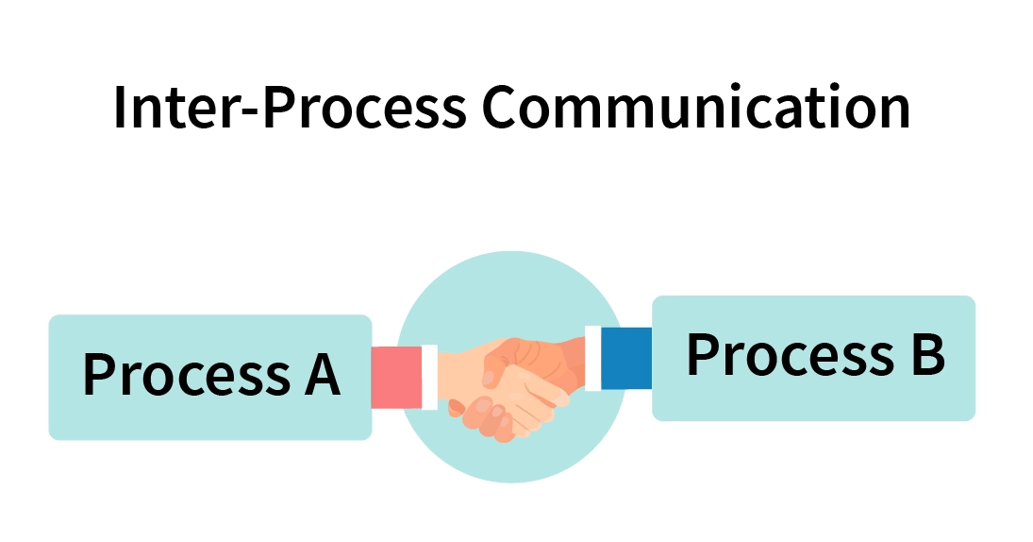
Part A: Design of the Coordination System
Part A of our presentation delves into the core of our IPC-Based Process Coordination System.
This section provides a detailed examination of the architectural design, outlining the system's structural framework, the critical components, and the roles they play in ensuring efficient process coordination.

Slide 4
Part B: Implementation of Synchronization Primitives
Semaphores
Mutexes
Semaphores are fundamental synchronization tools used to control access to shared resources and manage process coordination.
#include <semaphore.h> // Initialize a semaphore with an initial value of 1 sem_t semaphore; sem_init(&semaphore, 0, 1);
Mutexes, short for mutual exclusion, play a pivotal role in ensuring that only one process or thread accesses a resource at a time.
#include <pthread.h> // Initialize a mutex pthread_mutex_t mutex; pthread_mutex_init(&mutex, NULL);

Slide 5
Condition Variables
Condition variables are an integral part of our synchronization strategy. They allow processes to wait until a particular condition is met before proceeding. We'll illustrate their implementation and provide examples of how they are utilized for complex synchronization scenarios.
#include <pthread.h>
// Initialize a condition variable
pthread_cond_t condition;
pthread_cond_init(&condition, NULL);

Slide 6
Part C: Implementation for Solving Classical Problems
Part C of our presentation is the culmination of our IPC-Based Process Coordination System's journey. In this section, we explore how the system is applied to address classical synchronization problems that are often encountered in multi-process environments. We will provide practical examples and solutions for two such problems:
the Producer-Consumer Problem and the Dining Philosophers Problem.

Slide 7
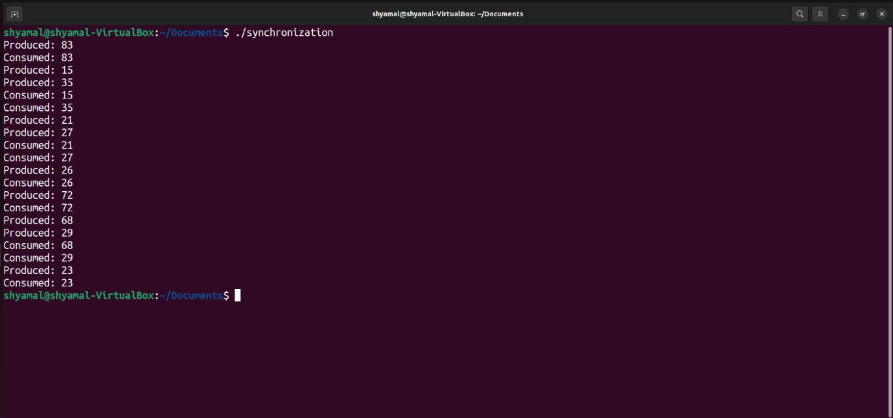
Producer-Consumer Problem
The Producer-Consumer Problem is a classic synchronization challenge where producers generate resources, and consumers consume them. The IPC-Based Coordination System offers an effective solution to this problem. In this section, we will delve into how our system handles this scenario, ensuring that producers and consumers work in harmony.

Slide 8
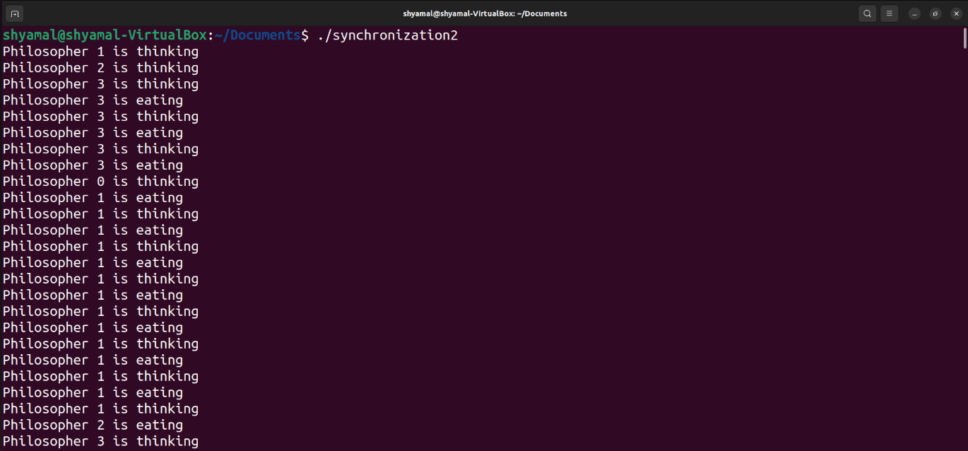
Dining Philosophers Problem
The Dining Philosophers Problem is another classic synchronization puzzle that involves philosophers sitting around a dining table and sharing forks. To prevent deadlock, philosophers must coordinate their actions. Our IPC-Based Coordination System offers a robust solution to this problem.

Slide 9
Conclusion
In conclusion, our IPC-Based Process Coordination System is not just a concept; it's a powerful solution to a fundamental challenge in modern computing—efficient process coordination. By exploring the design, the implementation of synchronization primitives, and its application to classical synchronization problems, we've demonstrated the system's remarkable capabilities.

